Slide 1
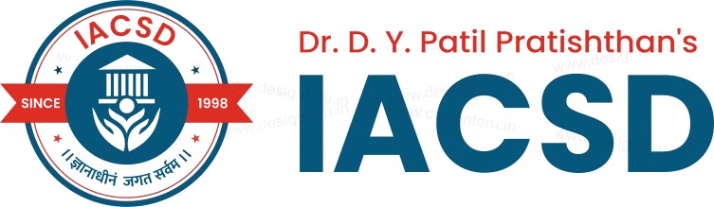

Title:- End-to-End DevSecOps and GitOps Kubernetes Platform with SonarQube, Trivy, Automated CI/CD, Monitoring, & Canary Deployments
Dr. D. Y. Patil Pratishthan's
Institute for Advanced Computing and Software Development
Project Presentation
GROUP NO. 07
SUMIT BADGUJAR 258439
KETAN MAHAJAN 258451
MRS. SUSHMA HATTARKI
PROJECT GUIDE
MR. ANIL SHARMA
CENTRE CO-ORDINATOR

Slide 2




Why DevSecOps + GitOps?
Traditional DevOps practices often treat security as an afterthought, creating vulnerabilities that can be exploited. By combining DevSecOps principles with GitOps workflows, we create a secure, auditable, and automated deployment pipeline.
Integrated Security
Single Source of Truth
DevSecOps embeds security checks throughout the entire CI/CD lifecycle, not just at the end
Git serves as the authoritative source for infrastructure and application configurations
Automated Deployments
Complete Auditability
GitOps ensures desired state reconciliation with automatic deployment when changes are committed
Every change is tracked, versioned, and auditable through Git history and commit logs

Slide 3
Project Overview: What We Built
This project implements an end-to-end GitOps workflow that integrates comprehensive security scanning at multiple critical stages. The system combines automated vulnerability detection with Git-based deployment orchestration to ensure secure, reliable Kubernetes deployments.
01
Pre-commit Security Checks
02
CI/CD Pipeline Scanning
Local validation of code and manifests before commits
Automated vulnerability scanning and quality gates
03
ArgoCD Deployment
04
Runtime Security
GitOps-driven state reconciliation
Container and manifest security verification

Slide 4





Project Architecture & Key Components
The platform integrates industry-standard tools to create a robust, secure deployment pipeline. Each component plays a specific role in ensuring security and reliability throughout the deployment process.
Kubernetes Cluster
ArgoCD
GitHub Actions
Minikube or cloud-based deployment target managing container orchestration and scaling
Continuous GitOps deployment controller ensuring desired state reconciliation and automatic sync
CI/CD automation engine running security scans and deployment workflows on every change
Trivy & KubeSec
Pre-commit Framework
Container and manifest vulnerability scanners detecting security issues before deployment
Early detection of security issues through local hooks preventing problematic code from entering

Slide 5

Security Scanning: Pre-commit Hooks
Early Detection Strategy
Pre-commit hooks automatically scan code and Kubernetes manifests before commits reach the repository. This prevents insecure code or misconfigurations from entering the codebase in the first place.
How It Works
.pre-commit-config.yaml triggers automated YAML linting and vulnerability scans
Scans run locally before any code is pushed to remote repository
Immediate feedback loop reduces costly fixes downstream
Customizable rules ensure team standards are maintained

Slide 6




CI/CD Pipeline Security Checks
The GitHub Actions pipeline executes comprehensive security checks on every push and pull request, ensuring only verified, secure code progresses through the deployment pipeline.
Code Push
Developer pushes changes to GitHub repository
Container Scan
Trivy analyzes container images for critical vulnerabilities
Manifest Scan
KubeSec checks Kubernetes configurations for misconfigurations
Quality Gate
Build fails if security issues detected, blocking deployment

Slide 7


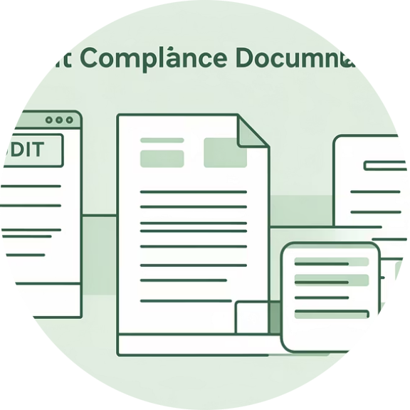
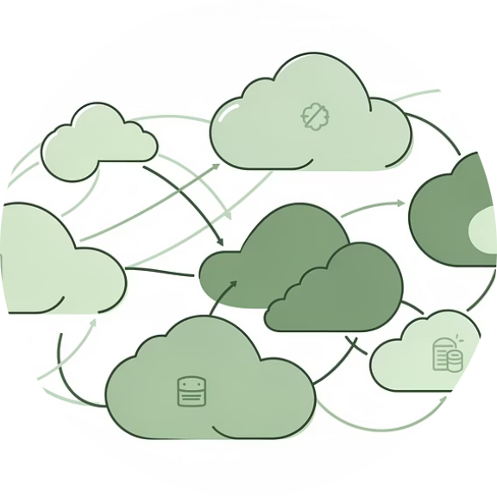
Benefits & Impact
Strong Security Posture
Faster, Safer Deployments
Improved Auditability
Scalable Approach
Git as source of truth provides complete audit trail for compliance and security reviews
Architecture adapts to any Kubernetes environment from development to enterprise production
Automated vulnerability detection at multiple stages prevents security issues from reaching production
Reduced manual intervention while maintaining security controls accelerates release cycles

Slide 8

Challenges & Future Enhancements
While the current implementation provides solid security foundations, several areas offer opportunities for improvement and expanded capabilities.
Extended Scanning
Secrets Management
Expand coverage to include dependency analysis and runtime security monitoring for complete protection
Secure handling of sensitive credentials within GitOps workflows using tools like SOPS or sealed secrets
Enhanced Observability
Policy Enforcement
Add Prometheus and Grafana dashboards for real-time security metrics and deployment visibility
Integrate OPA/Gatekeeper for automated policy validation ensuring compliance with security standards

Slide 9
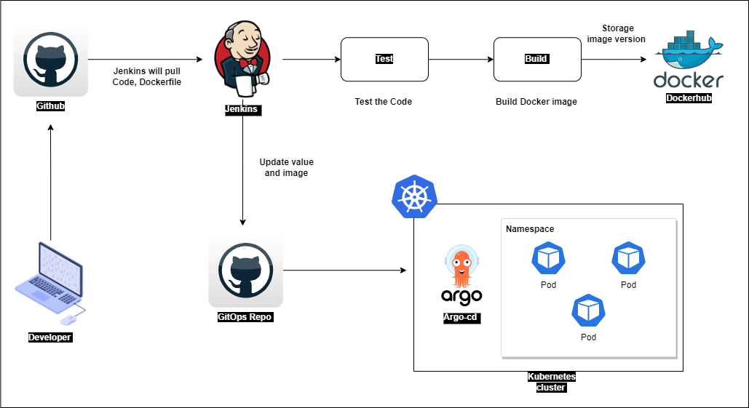
Get Started & Explore the Project
Ready to Implement Secure GitOps
Use the repository and deploy on your Kubernetes cluster. Customize the security scans to match your organization's requirements and security policies.
Project Resources
GitHub Repository: secure-gitops-devsecops-platform
Complete documentation and setup instructions included
Extensible architecture for adding custom security checks
Questions & Demo
Join the DevSecOps movement: secure your deployments with GitOps today!
Ready to see it in action? Let's explore the implementation together and discuss how to adapt it to your environment.

Slide 10
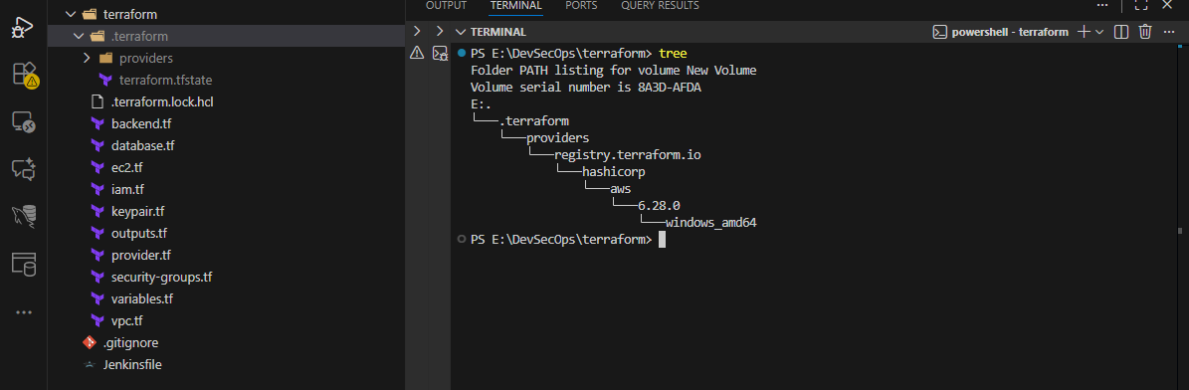
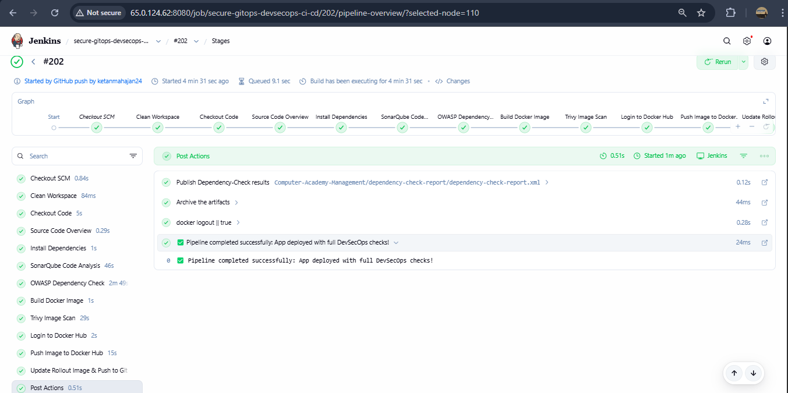

Slide 11
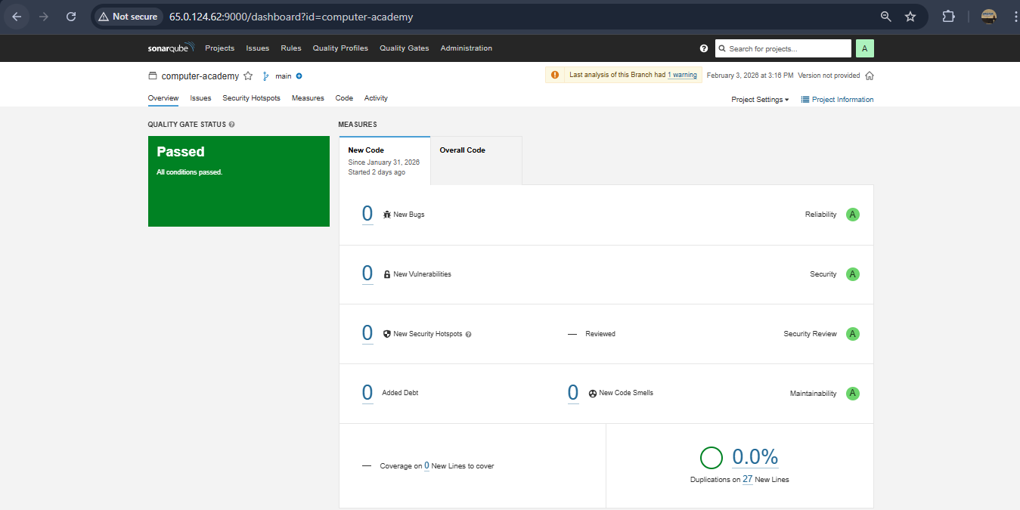
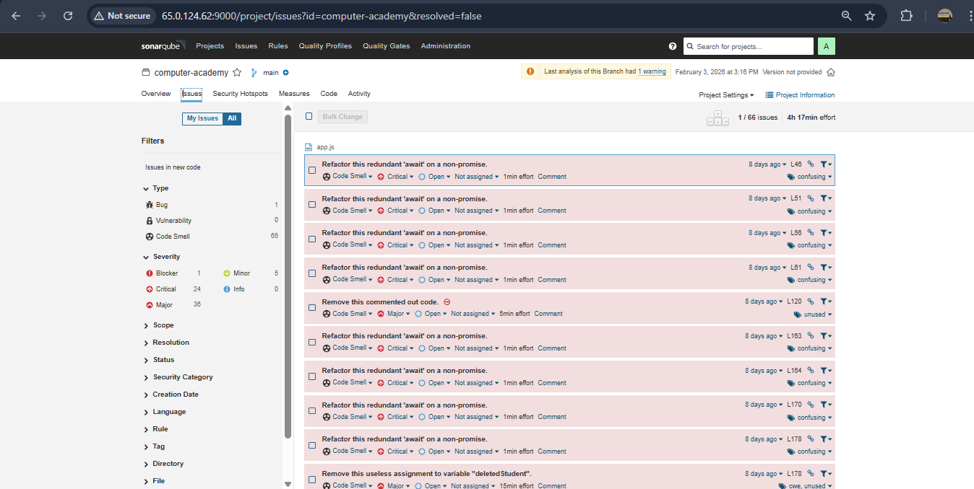

Slide 12
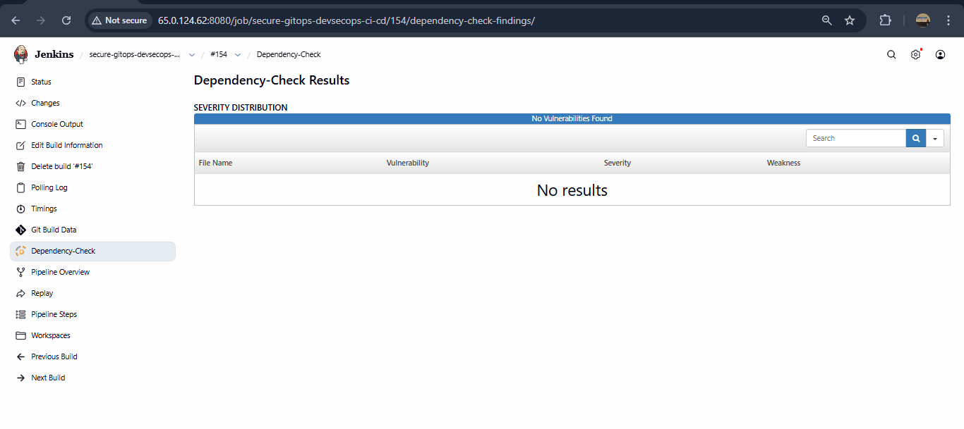
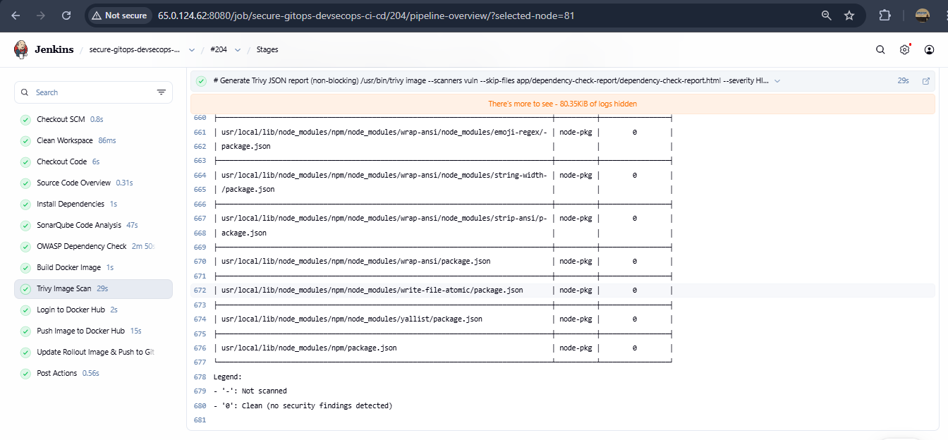

Slide 13
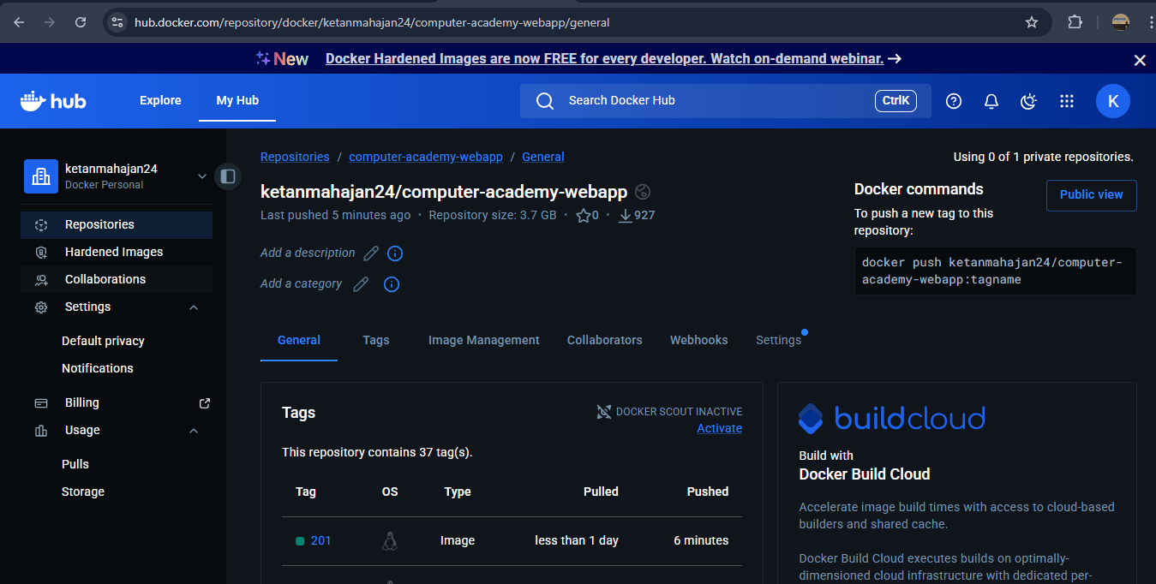
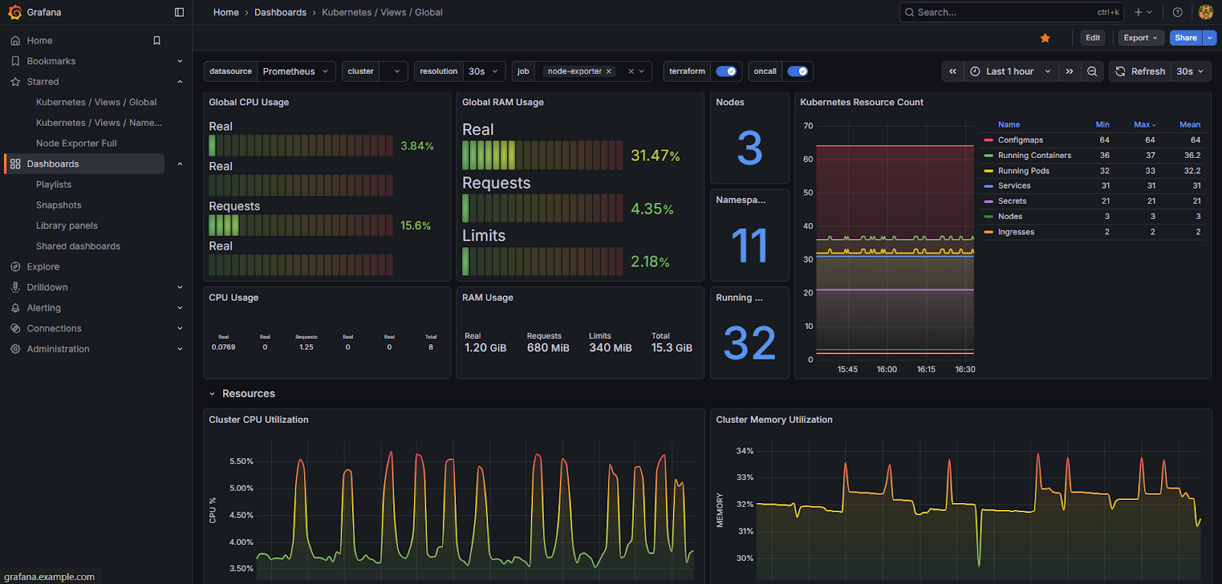

Slide 14
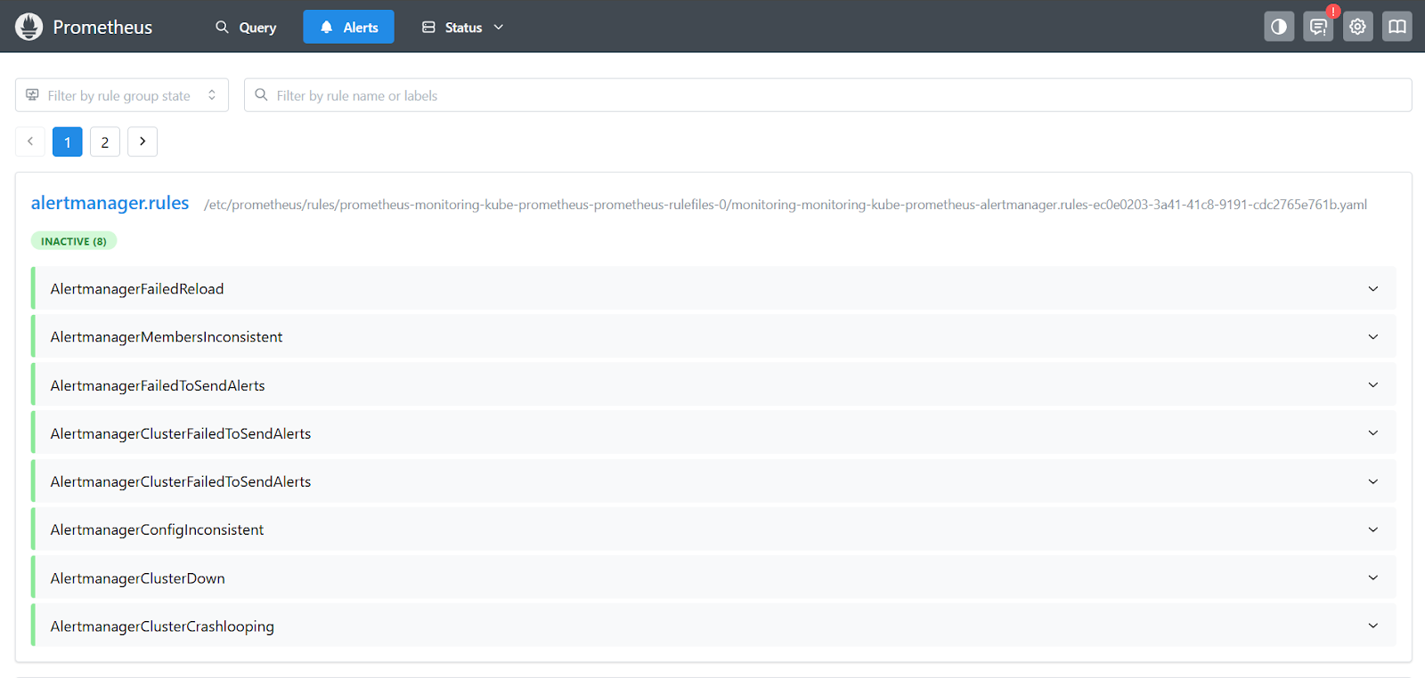
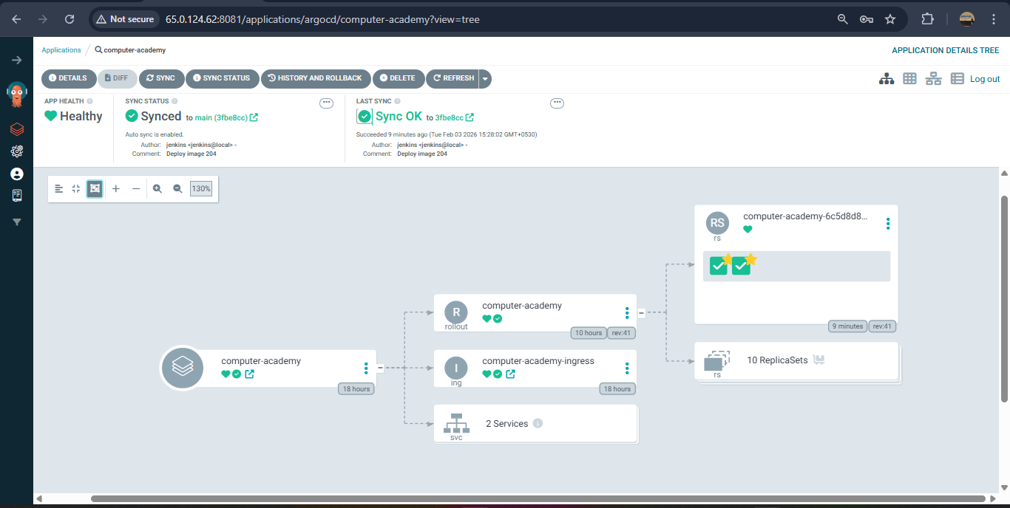

Slide 15
Thank You

